Slide 1
Lecture 16:
Dynamic Modeling (1)
Interaction Diagrams

Slide 2
A Software Development Methodology
Analysis Phase
User Requirements
Use Cases
Specification
Names of things
Names of relationships
Names of actions
Notes:
Three Models: Object Model, Behavioural Model, Functional Model.

Slide 3
A Software Development Methodology
Design Phase
Names
Specification
Relationships
Actions
Use Cases
Objects
obj1
obj2
obj3
Behaviour
object1 object 2 object 3
Classes
message
Developed Model
Code
Notes:
Three Models: Object Model, Behavioural Model, Functional Model.
What is missing?
testing
Developed model is not a final diagram it is the collection of everything

Slide 4
Developing the Dynamic Model
Creating a dynamic model by
preparing interaction diagrams
  collaboration diagrams
  sequence diagrams
identifying events between objects from these
building a state diagram
Notes:
UML uses the term interaction diagrams to cover sequence diagrams and collaboration diagrams.
The point of these diagrams is to identify associations between classes required to support behaviour. So information will be transferred from these diagrams to the class daigrams.
I began the lecture by informally sketching on the board a seqence diagram to show the passing of messages between objects and a collaboration diagram to show haw the messages are played out on the object model.

Slide 5
Developing the Dynamic Model
Completed Use Case
Completed static structure - Class/Object diagrams
Collaboration
  Group of objects - Module
Order
OrderLine
Part
Customer
Common Accessories
Notes:
UML uses the term interaction diagrams to cover sequence diagrams and collaboration diagrams.
The point of these diagrams is to identify associations between classes required to support behaviour. So information will be transferred from these diagrams to the class daigrams.
I began the lecture by informally sketching on the board a seqence diagram to show the passing of messages between objects and a collaboration diagram to show haw the messages are played out on the object model.

Slide 6
Developing the Dynamic Model
Completed Use Case
Completed static structure - Class/Object diagrams
Collaboration
  Group of objects - Module
For a particular
Use-Case
Get Total Order Cost
1 has *
:Order
:OrderLine
1
Associated
1
:Customer
Notes:
UML uses the term interaction diagrams to cover sequence diagrams and collaboration diagrams.
The point of these diagrams is to identify associations between classes required to support behaviour. So information will be transferred from these diagrams to the class daigrams.
I began the lecture by informally sketching on the board a seqence diagram to show the passing of messages between objects and a collaboration diagram to show haw the messages are played out on the object model.

Slide 7
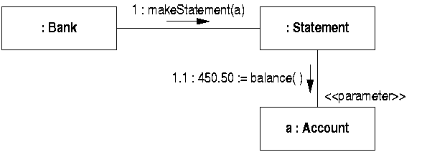
Collaboration Diagram
Shows association only once as with collaborating objects.
Messages are numbered to indicate the order in which they are sent.
Massages can be numbered sequentially for simple diagrams, but more commonly a hierarchical numbering scheme is used.
The rationale for adopting this hierarchical scheme is to enable the numbering of messages to reflect explicitly the structure of nested activation that is made explicit on the sequence diagram.

Slide 8
Collaboration Diagram
Collaboration diagrams do not include return arrows at the end of activations, as these would complicate the diagram.
Data that is returned from a message is prefixed to message name, and separated from it by an assignment symbol ‘:=’

Slide 9
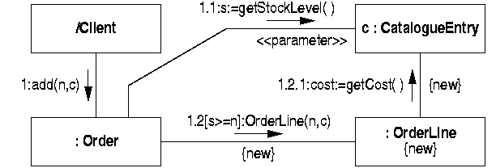
Collaboration Diagram (example 1)
Conditions can also appear on collaboration diagrams

Slide 10
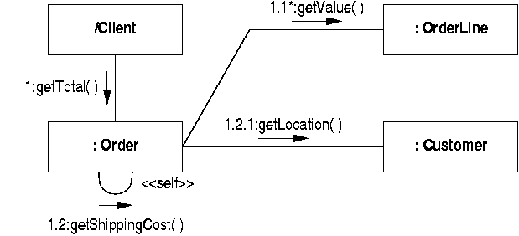
Collaboration Diagram (example 2)
On collaboration diagrams an extra level of message numbering is generated for messages to self.

Slide 11
Mapping the Collaboration Diagram
The object at the tail of the message arrow must have a reference to the object at the head
The object at the tail must call the routine in the other object
The object at the head of the arrow must have a routine to handle the message

Slide 12
The effect on the class model
Originally:
Order
OrderLine
Customer
Modified by sequence required:
Order
OrderLine
Customer
getValue( )
getShippingCost( )
getLocation( )
Routines containing the message call
Notes:
To summarise, the sequence diagram contains information which can be transferred to the object model. The object model represents certain parts of the code to be written.

Slide 13
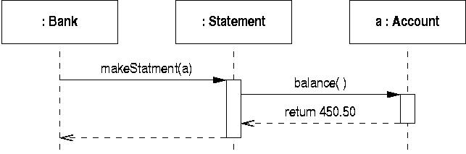
Sequence Diagram
The boxes at the top represent objects
The vertical dashed line descending from an object is called the object’s lifeline
The rectangle on the lifeline represents “activation” of the object, that is, running code in the class of that object using data in the object
Return messages are optional on a sequence diagram, but using them systematically often makes it much easier to discern the structure of an interaction
Notes:
The boxes at the top represent objects.
The vertical line descending from an object is called the object’s lifeline.
The rectangle on the lifeline represents “activation” of the object, that is, running code in the class of that object using data in the object.
UML does not demand activation rectangles, but there is a strong case to be made that it reduces ambiguity.

Slide 14
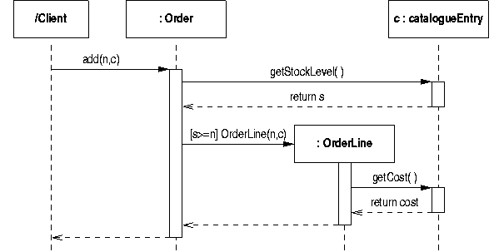
Sequence Diagram (example 1)
- Adding an item to an order creates a line (:OrderLine).
- Conditions (e.g. [s>=n] ) can be added to messages to show the situations when they are sent.
Notes:
The boxes at the top represent objects.
The vertical line descending from an object is called the object’s lifeline.
The rectangle on the lifeline represents “activation” of the object, that is, running code in the class of that object using data in the object.
UML does not demand activation rectangles, but there is a strong case to be made that it reduces ambiguity.

Slide 15
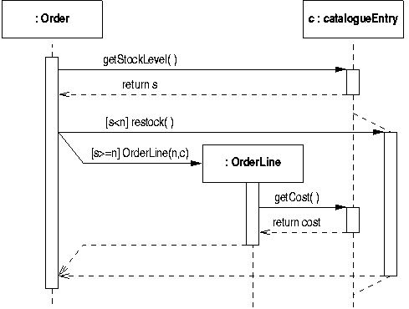
Sequence Diagram (example 2)
- Restock when an item runs out.
X
Notes:
The boxes at the top represent objects.
The vertical line descending from an object is called the object’s lifeline.
The rectangle on the lifeline represents “activation” of the object, that is, running code in the class of that object using data in the object.
UML does not demand activation rectangles, but there is a strong case to be made that it reduces ambiguity.

Slide 16
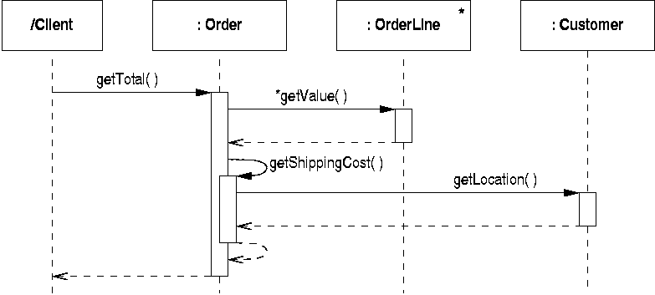
Sequence Diagram (example 3)
- Messages to self generate nested activations.
Notes:
The boxes at the top represent objects.
The vertical line descending from an object is called the object’s lifeline.
The rectangle on the lifeline represents “activation” of the object, that is, running code in the class of that object using data in the object.
UML does not demand activation rectangles, but there is a strong case to be made that it reduces ambiguity.

Slide 17
Mapping the Sequence Diagram to the Object Model
The arrows represent messages sent from one object to another.
The class of the sending object is at the tail of the arrow – the sending class
The class of the receiving object is at the head of the arrow – the receiving class
This means:
The sending class must know about the receiving class – this is done with a declaration
The receiving class must handle the message – this is done with a routine in the receiving class
The sending class must call the routine in the receiving class
Notes:
In the class at the tail of an arrow, there must be a declaration of a variable of the type of the class at the head of the arrow:
class FSM
feature
fixture: FIXTURE – The declaration
end
In the class at the head of the arrow, there must be a declaration of the routine which implements the actions required of the message:
class FIXTURE
feature
make_rounds is – the rotuine to handle the message
do
-- This will get filled out later to implement the message.
end
end
In the class at the tail of the arrow, there must be code which “sends the message”/”calls the routine”
class FSM
feature
fixture: FIXTURE
initialise is
do
fixture.make_rounds – the call which sends the message
end
end

Slide 18
Hierarchical Message Numbering Example
1
1.1
1.2
Question:
Draw a collaboration diagram showing the same structure of interactions as the sequence diagram shown on the left.
2
2.1
2.1.1
2.1.2
2.2
2.2.1

Slide 19
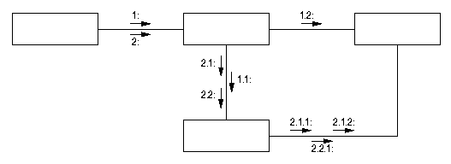
Suggested Answer to the Question

Slide 20
Comparing sequence and collaboration diagrams
Both kinds of diagrams are very simple
They both capture information which can be mapped immediately and directly to the class model and code
Use these diagrams when you want to show behaviour of several objects
Sequence diagrams can be lengthy
Collaboration diagrams can be vague

Slide 21
Comparing sequence and collaboration diagrams
Alternative ways of expressing the same information.
Use sequence diagrams useful for ensuring ordering/timing because time is inherently visible.
Collaboration diagrams useful for verifying data links/path are available because they show associations.

Slide 22
Summary
Two kinds of diagrams for dynamic modelling
  Sequence diagram
  Collaboration diagram
Conversion between these two diagrams
Mapping dynamic models to object models
Comparison of two kinds of diagrams

Slide 23
Readings
Mark Priestley: “Practical Object-Oriented Design with UML”
  Chapter 9: Interaction Diagrams (2nd edition)
  Chapter 10: Statecharts (2nd edition)
  or
  Chapter 7: Interaction Diagrams (1st edition)
  Chapter 8: Statecharts (1st edition)

